Slide 1
The ECC in practice, its structure, its working process
CEPT Workshop on European Spectrum Management and Numbering
5th April 2016

Slide 2
Scope
ECC: its framework
ECC: its organisation
ECC Deliverables
ECC Work Items
Participation to the ECC
ECC communications

Slide 3
ECC: What we do
Develops policies and work programme on spectrum, numbering and network matters in an European context;
Brings together expertise in managing scarce resources;
Offers a forum for the European preparation of ITU work;
Acts as recognised spectrum and nubering expert for CEPT Administrations and for the European Commission;
Provides a focal point for information (EFIS etc.) on electronic communications;
Fosters cooperation with other bodies and stakeholders
http://www.cept.org/ecc
http://cept.org/ecc/who-we-are/what-we-do

Slide 4
ECC: framework
http://www.cept.org/ecc/framework
Rules of Procedure (RoP):
High level rules on the structure, the participation, chairmanships, documentation, organisation of meetings
Mechanism for ECC Decisions (development, approval, implementation, review...)
Principles for conduct of meeting: general rule is consensus (don’t imply unanimity). Voting on an exceptional basis (Plenary, WG)

Slide 5
ECC: framework
Working Methods
Details further the general rules of the RoP
Rules for the participation of observers
Mechanisms for ECC Recommendations, ECC Reports and CEPT Reports
Electronic working arrangements
enhance meeting participation and efficiency.
Guidelines on the organisation and participation in web-meetings, webinars, virtual participation in meetings.
Addresses also electronic features provided by the CEPT portal.

Slide 6
ECC: framework
ECC strategic plan for 2015-2020
Identifies skills and actions to be developed in:
Expertise in managing scarce resources
Spectrum management
Numbering and resources
Europe wide forum for the work in ITU
Cooperation with the European Commission, ETSI, others…
Focal point in Europe for information on electronic communication
Identifies challenges in spectrum management and numbering – principles and major topics
http://www.cept.org/ecc/who-we-are/ecc-strategic-plan

Slide 7
ECC: organisation
Electronic
Communications Committee
Chairman: E. Fournier (F)
Vice-Chairmen: S. Pastukh (RUS) J. Afonso (POR)
Steering Group
European
Communications Office
Director: P. Christensen (DNK)
Deputy Director: B. Espinosa (F)
WG CPG
WG FM
WG SE
WG NaN
ECC PT1
Conference
Preparatory Group
Frequency
Management
Spectrum
Engineering
Numbering
and Networks
IMT-Matters
Chairman:
A. Kühn (D)
Vice-Chairmen:
To be decided
Chairman:
T. Weilacher (D)
Vice-Chairmen:
C. Reis (POR)
S. Talbot (G)
Chairman:
K. Loew (D)
Vice-Chairmen:
J. Duque (POR) k. Bejuk (HRV)
Chairman:
J. Vallesverd
(NOR)
Vice-Chairmen:
E. Greenberg (G)
F. Dragomir (ROU)
Chairman:
D. Chauveau (F)
Vice-Chairmen:
P. Toivonen (FIN)
S. Green (G)
Updated: March 2016

Slide 8
ECC: organisation WG FM
Developing strategies, plans and implementation advice for the management of the
radio spectrum
EFIS/MG
ECO Frequency Information
System Maintenance Group
Chairman: Stefan Mayer-Bidmon (D)
WGFM
Working Group Frequency Management
Chairman: Thomas Weilacher (D)
Vice Chairman: Cristina Reis (POR)
Vice Chairman: Stephen Talbot (G)
SRD/MG
Short Range Devices
Maintenance Group
Chairman: Thomas Weber (ECO)
FM22 – Spectrum Monitoring and
Enforcement
Chairman: Ralf Trautmann (D)
WGFM Civil Military Forum
FM44 – Satellite Communications
Chairman: Amar Saidani (F)
WGFM Correspondence Groups
BB-Maritime Links: Chairman - Eirik Bliksrud (N)
Drones: Chairman - Florian Cziczatka (A)
FM49 – Radio Spectrum for Public
Protection and Disaster Relief (PPDR)
Chairman: Laurent Bodusseau (F)
FM51 – PMSE Chairman: Lindsay Cornell (G)
FM Maritime FG
WGFM Maritime Forum Group
Chairman: Jaap Steenge (NL)
FM54 – Private/Professional Land Mobile
Systems/ esp. for Railways
Chairman: Kuha Sithamparanathan (G)
FM Radio Amateur FG
WGFM Radio Amateur Forum Group
Chairman: Thomas Weber (ECO)
FM55 – 5 GHz WAS/RLAN
Chairman: Andrew Gowans (G)

Slide 9
ECC: organisation WG SE
Developing technical guidelines and
sharing and compatibility arrangements
for radio spectrum use by various radiocommunications services
STG – SEAMCAT
Technical Group
Chairman:
José Carrascosa (ECO)
SE7 – Compatibility and sharing
issues of mobile systems
Chairman:
P. Jokela (FIN)
SE19 – Fixed Service
Chairperson:
S. Tereshchenko (RUS)
WGSE
Working Group
Spectrum Engineering
Chairman:
K. Loew (D)
Vice chairmen:
J. Duque (POR)
K. Bejuk (HRV)
SE21 – Unwanted
Emissions
Chairperson:
M. Pavsek (SVN)
SE24 – Short Range
Devices
Chairman:
Fatih M. Yurdal
(Yurdal Consult)
SE40 – Space Services
Compatibility Issues
Chairperson:
S. Contreras (France)
FG Wind Turbines – Forum Group on Wind Turbines
Convener:
Hans Sundkvist (Sweden)
FG on MCA NCU – Forum Group on unwanted emissions
Updated: February 2016

Slide 10
ECC: organisation WG NaN
Developing policies in numbering, naming and addressing and advising on technical regulatory matters to promote telecom innovation and competition
WG NaN
Numbering & Networks
Chairman: J. Vallesverd (NOR)
Vice-Chairman: E. Greenberg (G)
F. Dragomir (ROU)
PT TRIS
PT FNI
PT NP
PT ES
Technical
Regulatory Issues
Future
Numbering Issues
Number
Portability
Emergency
Services
Chairman:
V. Stundzia (LTU)
Chairman:
F. Bernabei (IT)
Chairman:
J.F. Silva (POR)
Chairman:
F. Dragomir (ROU)

Slide 11
ECC: organisation WG CPG
Prepare European positions for ITU World Radiocommunication Conferences (WRCs) and Radiocommunication Assemblies (RAs)
Chairman: Alexander Kühn (D)
Structure (Project Teams and allocation of agenda items) and vice-chairmanships to be decided at the first CPG meeting for the WRC cycle 2016-2019 (12-14 April 2016)

Slide 12
ECC Deliverables (1)
ECC Decisions
Aim at harmonisation in the electronic communications regulatory field:
“Designate" a frequency band for harmonisation matters.
Voluntary basis: Members implementing the Decision commit themselves
ECC Recommendations
Measures which administrations are encouraged to apply
Harmonisation measures for those matters where Decisions are not yet relevant or to provide guidance to national administrations

Slide 13
ECC Deliverables (2)
ECC Reports
Result of studies by the ECC normally in support of a harmonisation measure
CEPT Reports
Result of studies by the ECC in response to Mandates from the EC.

Slide 14
Flow of ECC Deliverables
Concensus on Draft
Decision
Recommendation
Report (ECC and
CEPT)
2 weeks
window for
Admin veto (*)
Public Consultation open for all
Project
Team
at least 6 weeks
Working
Group
Assessing
the comments
A veto returns
a Deliverable
back to a group
ECO
Analysis
Approval
Final
Deliverables
Publication
on ECO
Document
database
Project
Team
Working
Group
Working
Group
ECC
Plenary
http://www.ecodocdb.dk/
(*) Not applicable if approved for Public Consultation
by the ECC Plenary

Slide 15
ECC Deliverables
Decisions: approved for Public Consultation by WGs or the ECC Plenary. Final adoption by the ECC Plenary
Recommendations and Reports may be (unanimously) approved by WGs
CEPT Reports in response to EC Mandates approved by the ECC Plenary and sent to the EC
Published on the ECO Documentation Database (http://www.ecodocdb.dk/ )

Slide 16
ECC Work Items
ECC entities adopt Work Items which constitute the ECC Work Programme
Administrations (4 supporting administrations)
Industry (ETSI)
Exchanges of information between ECC and ETSI during the development of deliverables relating to spectrum management (http://www.cept.org/ecc/about-ecc/ecc-etsi)
Finalized Work Items usually result in ECC Deliverables
ECC work items are included within the ECC Work Programme Database (http://eccwp.cept.org/ )

Slide 17
ECC Participation
Members of CEPT are Members of the ECC as of right
Representatives of the European Commission and of the European Free Trade Association Secretariat are Counsellors of the ECC
MoUs and LoUs with CEPT or specifically with ECC: more than 40 organisations
Representatives of relevant inter-governmental organisations as well as other organisations or non-CEPT administrations concerned with electronic communications may be invited by the relevant Chairmen to participate as Observers in their meetings on an ad-hoc basis

Slide 18
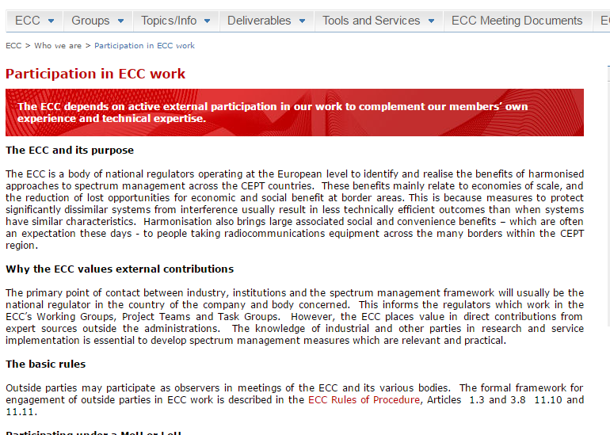
ECC’s external participation
The ECC depends on active external participation in our work to complement our members’ own experience and technical expertise.
Observers can participate in the ECC meetings when issues of mutual interest are placed on the agenda
http://www.cept.org/ecc/who-we-are/participation-in-ecc-work

Slide 19
ECC Communications
ECC Newsletters: http://cept.org/ecc/who-we-are/ecc-newsletters . 3-4 per year. Keep up-to-date with important spectrum and numbering policy issues being considered within the ECC.
News releases on the website.
Publication of monthly news summary to find out what's been going on in our Working Groups and Project Teams
Publication of presentations made by key ECC figures at conferences and workshops.
The ECC is on Twitter https://twitter.com/CEPT_ECC

Slide 20
Thanks for your attention!!
Questions??

